Slide 1
Virtual memory
Background

Slide 2
Need of virtual memory
The instructions being executed must be in physical memory. The first approach to meeting this requirement is to place the entire logical address space in physical memory.
Dynamic loading can help to ease this restriction, but it generally requires special precautions and extra work by the programmer.
The requirement that instructions must be in physical memory to be executed seems both necessary and reasonable; but it is also unfortunate, since it limits the size of a program to the size of physical memory
Programs often have code to handle unusual error conditions. Since these errors seldom, if ever, occur in practice, this code is almost never executed.
Arrays, lists, and tables are often allocated more memory than they actually need.
Certain options and features of a program may be used rarely

Slide 3
The ability to execute a program that is only partially in memory would confer many benefits:
• A program would no longer be constrained by the amount of physical memory that is available. Users would be able to write programs for an extremely large virtual address space, simplifying the programming task.
• Because each user program could take less physical memory, more programs could be run at the same time, with a corresponding increase in CPU utilization and throughput but with no increase in response time or turnaround time.
• Less I/O would be needed to load or swap user programs into memory, so each user program would run faster.

Slide 4
VIRTUAL MEMORY
Virtual memory involves the separation of logical memory as perceived by users from physical memory. This separation allows an extremely large virtual memory to be provided for programmers when only a smaller physical memory is available .
Virtual memory makes the task of programming much easier, because the programmer no longer needs to worry about the amount of physical memory available
In general, Virtual memory is a feature of an operating system that enables a computer to be able to compensate shortages of physical memory by transferring pages of data from random access memory to disk storage.

Slide 5
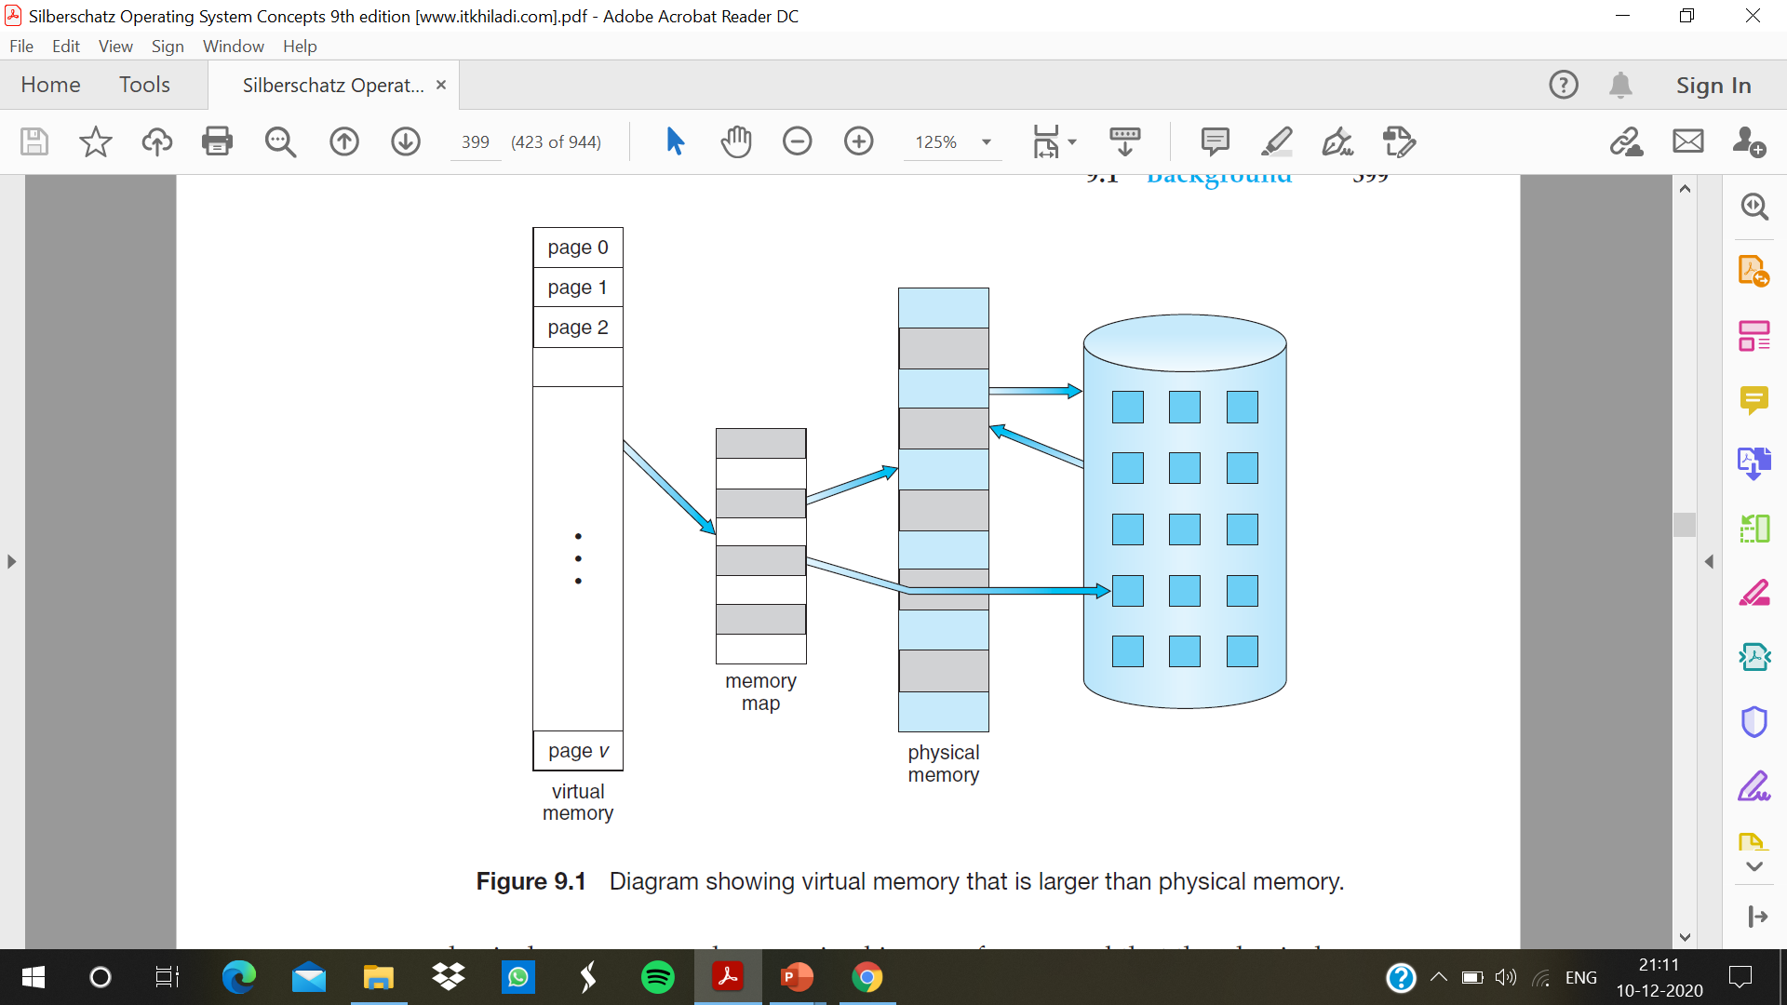

Slide 6
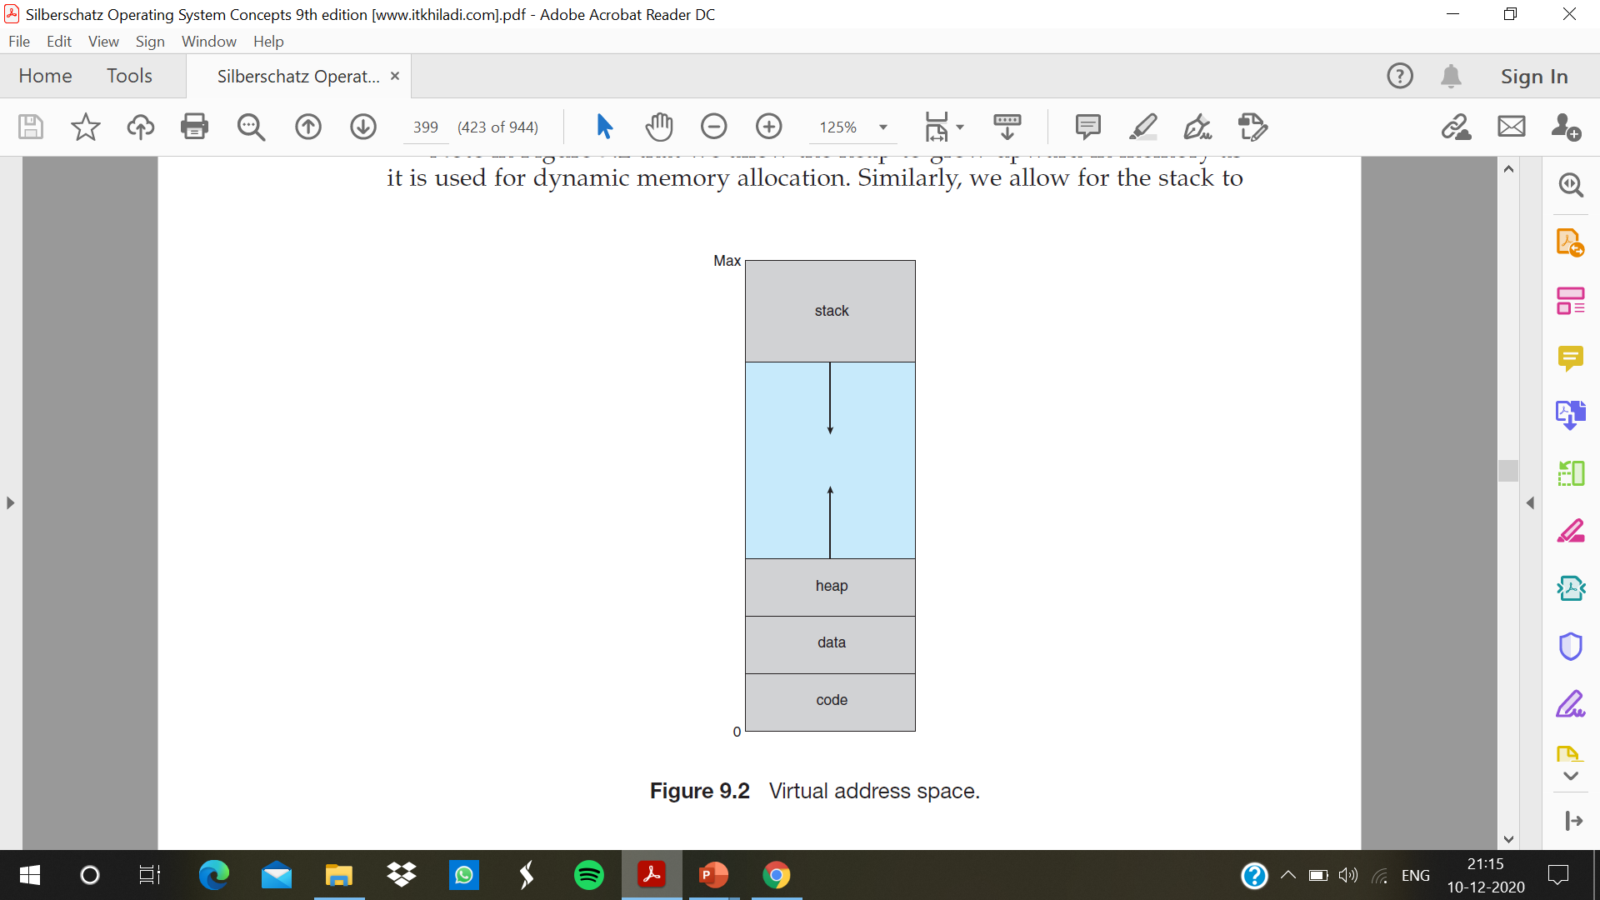
VIRTUAL ADDRESS SPACE
The virtual address space of a process refers to the logical (or virtual) view of how a process is stored in memory
The large blank space (or hole) between the heap and the stack is part of the virtual address space but will require actual physical pages only if the heap or stack grows.
Virtual address spaces that include holes are known as sparse address spaces. Using a sparse address space is beneficial because the holes can be filled as the stack or heap segments grow or can dynamically link libraries during program execution

Slide 7
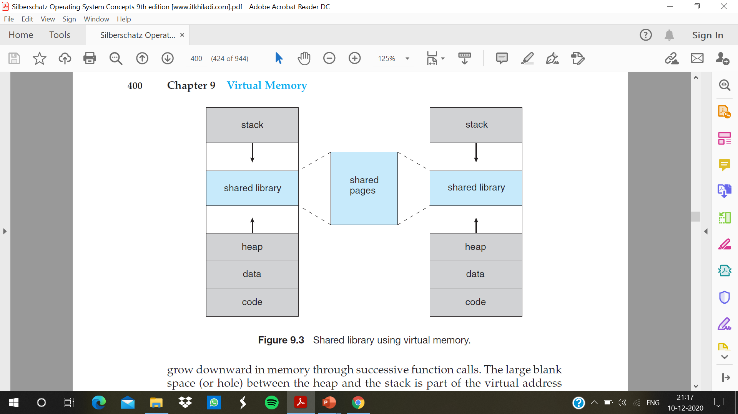

Slide 8
Virtual memory allows files and memory to be shared by two or more processes through page sharing. This leads to the following benefits:
• System libraries can be shared by several processes through mapping of the shared object into a virtual address space . Although each process considers the libraries to be part of its virtual address space, the actual pages where the libraries reside in physical memory are shared by all the processes
• Similarly, processes can share memory. Virtual memory allows one process to create a region of memory that it can share with another process.
• Pages can be shared during process creation with the fork() system call, thus speeding up process creation

